Slide 1
Gatsby Static Site Generator

Slide 2


Hello world!
I AM JEFF KEENE
I am here talk about my journey into static site generators.
You can find me at:
linkedin.com/in/master12
Notes:
Currently employed at DOI, Depart. Of Interior in the ONRR, Office of Natural Resources Revenue.
Team is NRRD, Natural Resources Revenue Data team

Slide 3
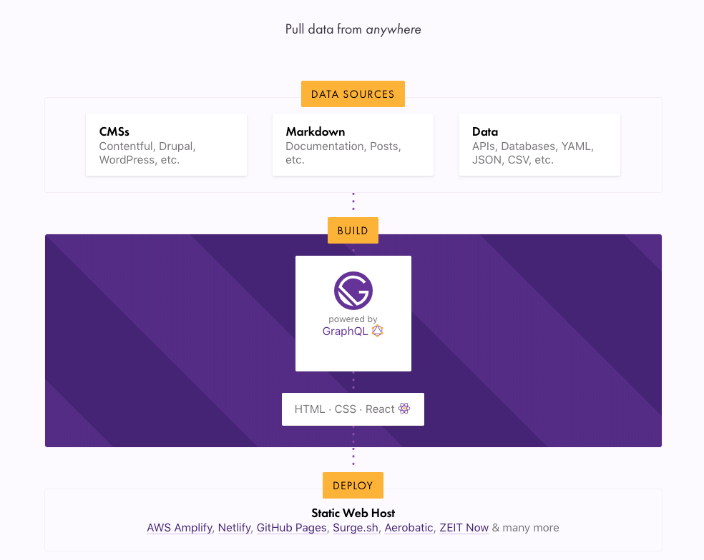
1 Gatsby
What is Gatsby?
const JAMstack = (React, Markdown) => Static web page
Notes:
Gatsby is a free and open source framework based on React that helps developers build blazing fast websites and apps
Pull data from anywhere
Builtin Graphql
Static doesnt mean not interactive or dynamic or able to connect to a server

Slide 4
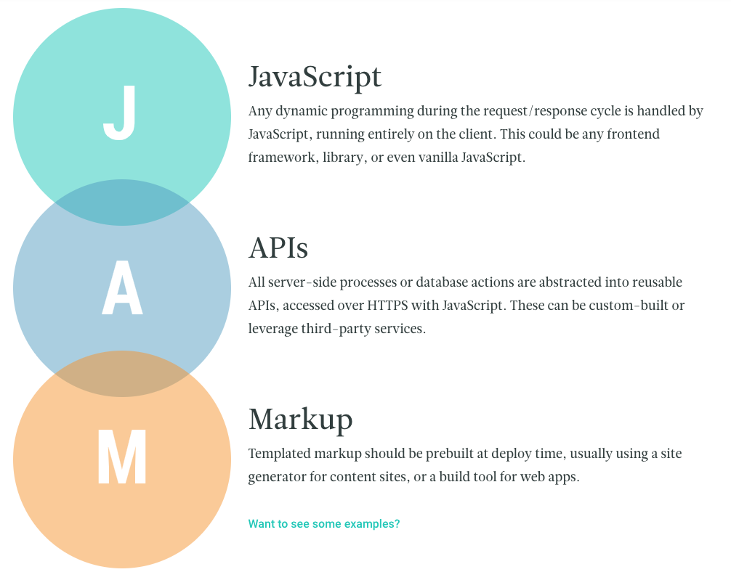
What is JAMstack?
A modern architecture —
Create fast and secure sites and dynamic apps with JavaScript, APIs, and prerendered Markup
Notes:
built using by hand, or with Jekyll, Hugo, Nuxt, Next, Gatsby
Why the JAMstack?
Better Performance
Why wait for pages to build on the fly when you can generate them at deploy time? When it comes to minimizing the time to first byte, nothing beats pre-built files served over a CDN.
Higher Security
With server-side processes abstracted into microservice APIs, surface areas for attacks are reduced. You can also leverage the domain expertise of specialist third-party services.
Cheaper, Easier Scaling
When your deployment amounts to a stack of files that can be served anywhere, scaling is a matter of serving those files in more places. CDNs are perfect for this, and often include scaling in all of their plans.
Better Developer Experience
Loose coupling and separation of controls allow for more targeted development and debugging, and the expanding selection of CMS options for site generators remove the need to maintain a separate stack for content and marketing.

Slide 5
2 Case Study
revenuedata.doi.gov
Data analytics site for DOI - ONRR
Notes:
Data analytics site for ONRR and was orginally built by 18f using Jekyll
However several issues with transitioning this to ONRR full time

Slide 6
Originally developed using Jekyll and Web components
Several issues and concerns that we had with the tech stack.
Data Updates
A developer had to run makefiles locally to update ~50 different yml files
Jekyll & Windows?
Jekyll not officially supported on Windows and had several compatibility issues
Dev Team of one
Tech stack included Jekyll, Ruby, makefiles, web components, D3, Liquid Templates, Markdown, YML

Slide 7
Why we chose Gatsby?
Allow anyone to update data/content
Allows for more frequent updates
Graphql for all data sources
Cross-platform friendly
Environment maintained by community
Customizable with plugins
Notes:
Data sources can be local and remote/apis
Can use a CMS for content
Tech stack that is sustainable for the long term and make it easy to transition to new team
Static site generators are getting more popular and this one is based on React which is of course one of the most popular UI frameworks
Gatsby has gotten lots of funding and a recent Series A 15 million

Slide 8
3 Let’s Code
Getting started with Gatsby
Notes:
Data analytics site for ONRR and was orginally built by 18f using Jekyll
However several issues with transitioning this to ONRR full time

Slide 9
WHAT TO THINK ABOUT?
Gatsby helpers:
What features do you need for your site?
Data? Multiple sources? Queries?
Content updates?
Recipes - https://www.gatsbyjs.org/docs/recipes/
Starting templates - https://www.gatsbyjs.org/starters/?v=2
Plugins - https://www.gatsbyjs.org/plugins/
Graphql - https://www.gatsbyjs.org/docs/why-gatsby-uses-graphql/
Cheatsheet - https://www.gatsbyjs.org/gatsby-cheat-sheet.pdf
Notes:
gatsby new gatsby-starter-default https://github.com/gatsbyjs/gatsby-starter-default
Review:
Folders
Scripts in package.json
Run develop
localhost:8000
http://localhost:8000/___graphql
Make changes to index page
Review gatsby config
pathPrefix, withPrefix and environment variables
Plugins
Site metadata
Review lifecycle
Gatsby node/API
https://www.gatsbyjs.org/docs/node-apis/
CREATE PAGES:
3 ways to create pages:
In your site’s gatsby-node.js by implementing the API createPages
Gatsby core automatically turns React components in src/pages into pages
Plugins can also implement createPages and create pages for you
We will demo 2
Debug info in graphql:
{
allSitePage {
edges {
node {
path
component
pluginCreator {
name
pluginFilepath
}
}
}
}
}
Create new page in pages folder custom
Copy page-2 and modify
Add new link to homepage
Demo live update
Show debug info
Create page from createPage
Template
Markdown
Gatsby node
Gastby config plugin install gatsby-transformer-remark
Review rehype-react
Graphql data
Add yaml file
Install 'gatsby-transformer-yaml'
Add useStaticQuery to template
dataYaml{
data_retrieval {
name
email
}
information_data_management {
name
street
city
zip
email
}
}
}
Graphql api
Install gatsby-source-graphql
Add to gatsby config:
{
resolve: "gatsby-source-graphql",
options: {
// This type will contain remote schema Query type
typeName: "SWAPI",
// This is the field under which it's accessible
fieldName: "swapi",
// URL to query from
url: "https://api.graphcms.com/simple/v1/swapi",
},
},
CMS example
Open netlify directory
https://app.netlify.com/sites/hungry-bhaskara-bad81f/overview
https://hungry-bhaskara-bad81f.netlify.com/
Npm run develop
Make changes and check in, see locally and on netlify
Questions?

Slide 10
4 Lessons Learned
What we learned about using Gatsby on revenuedata.doi.gov
Notes:
Data analytics site for ONRR and was orginally built by 18f using Jekyll
However several issues with transitioning this to ONRR full time

Slide 11
TOO MUCH DATA
A lot of data can slow initial build times
Notes:
Slow build times
API vs Client side data

Slide 12
Where does content go?
Do we have content in components and markdown?
Notes:
Slow build times

Slide 13
WHAT ARE WE PLANNING TO DO?
Client Data - 90%
Most of our content will have data only on the client and no api will be needed.
Runtime Api - 10%
For tools/ features on our site that need to access a lot fo data we wil leverage a API at run time.
CMS
Plan on leveraging a CMS for content. Will begin to eliminate as much content from components as it make sense. Will leverage custom react components in markdown.

Slide 14
5 Closing
HELP US!
User Research?
nrrd@onrr.gov
Notes:
Please help our site by participating in our User Resaerch

